Slide 1


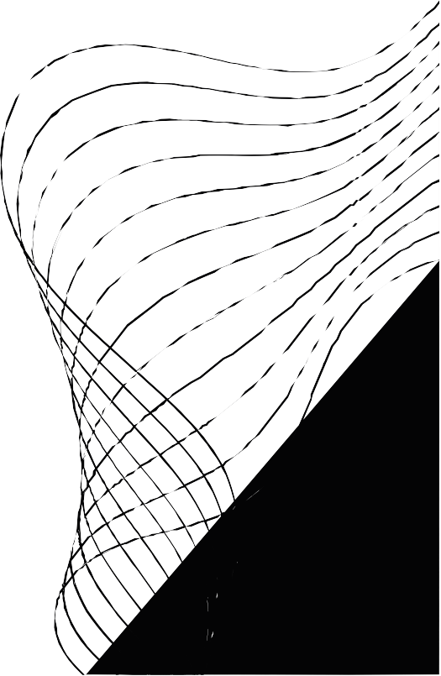
STUDENT RESULT
MANAGEMENT SYSTEM
( SRMS)
BY TEAM EXECUTIONERS:
KHYATI KACHHAWAH (002744287)
BASHU BISHT (002927465)
ATHARVA NIMBALWAR (002625645)
UNDER THE GUIDANCE OF
PROF. CHEN-HSIANG (JONES) YU, PH.D

Slide 2



OUR TEAM

Slide 3


PROJECT STATEMENT
Designing Student Result Management System which is a web application for teachers and professionals to manage and analyze the academic result of
students.

Slide 4


PROJECT TECHNICAL OVERVIEW
Project executed using Eclipse with Java, Java FX and FXML Used Maven dependencies to inject fxml and My SQL jar f i les MVC framework
FXML Doc( V) | | Java Files( C) | | Teacher and Student Result( M) Connection with database – JDBC

Slide 5


DATABASE AND MODELS
My SQL database ( ood_project) - Two tables
user_registration - ( Full name, email id, password)
student_result – ( id, email_id, f inal_grade, student_name, age, roll_no)
Designed a JdbcDao class to connect My SQL with Java controllers. JdbcDAO takes care of all CRUD operations
Created a User Session. java f i le to keep track of the teacher information t i l l the end of session.
Student. java - POJO class to retrieve all student data

Slide 6


DATABASE OPERATIONS
Implemented insert Record() and add Record() to add student result to the My SQL database.
Implemented set Record() method to update the student record.
Implemented get Record() and search Record() methods to search and get student result information added by the teacher logged in from
My SQL database.
Used delete Record() method to delete current student record added by the teacher from My SQL database.

Slide 7


OPERATIONS OVERVIEW
Roles:
. Teacher Role
Registration/ login
Student Result ( CRUD operations) Activity Log( Teacher)
. Admin Role
Search and Delete Teacher' s entry and student result added by that teacher
Activity Log( All Teacher)

Slide 8
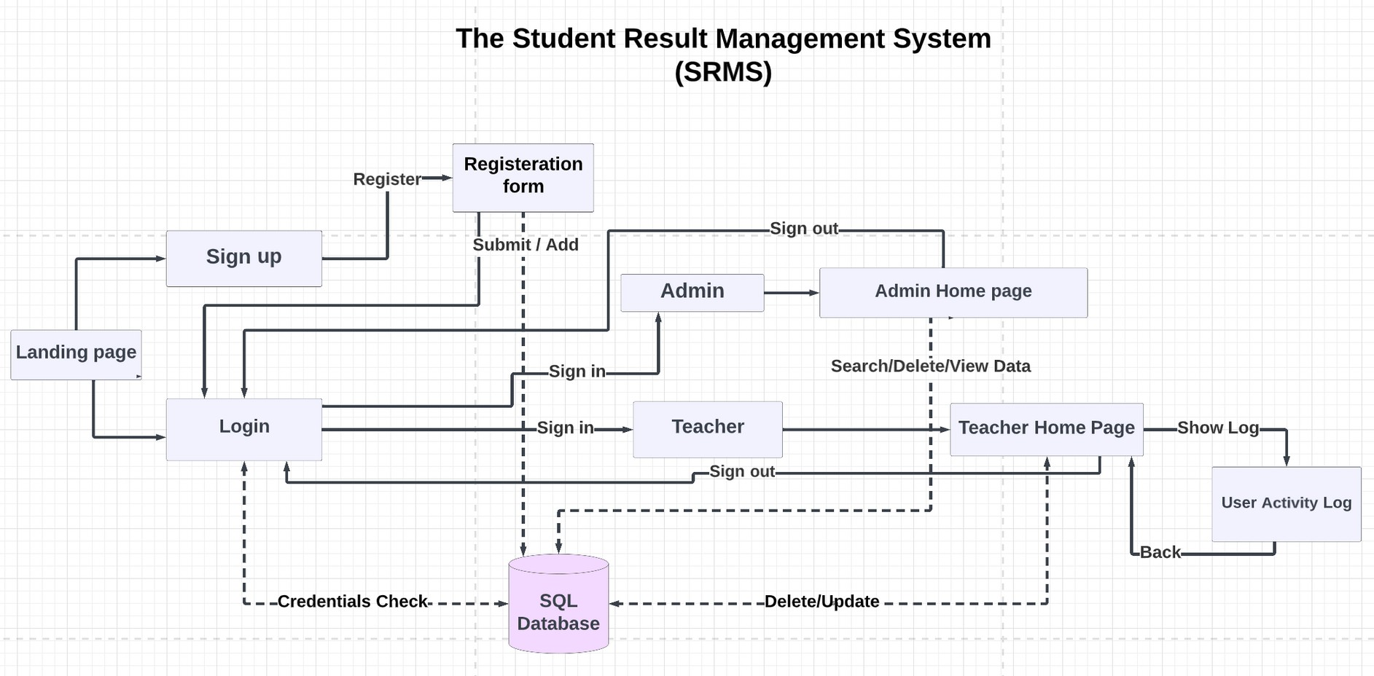
SYSTEM DESIGN

Slide 9
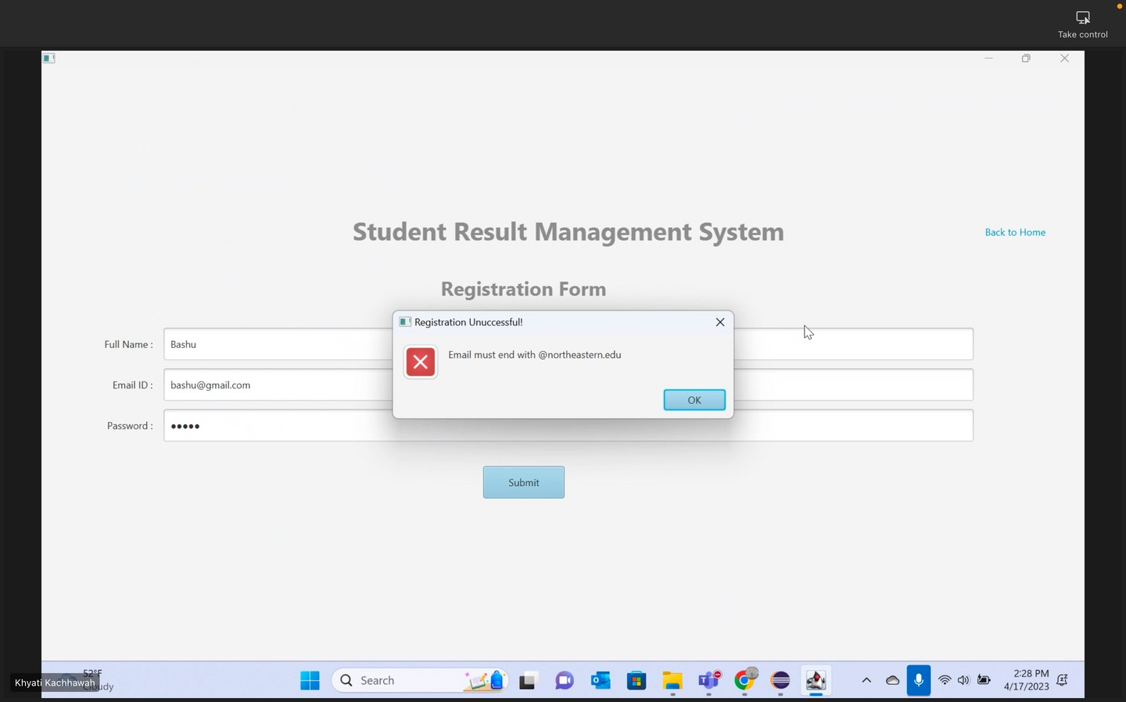
REGISTRATION PAGE
Home. fxml -> Primary. fxml ( registration page)
Alerts prevent user from
registering without entering all data in correct format
Submit button prompts java f i le to connect to DB and add teacher to User DB
On Successful registration -> Login. fxml

Slide 10
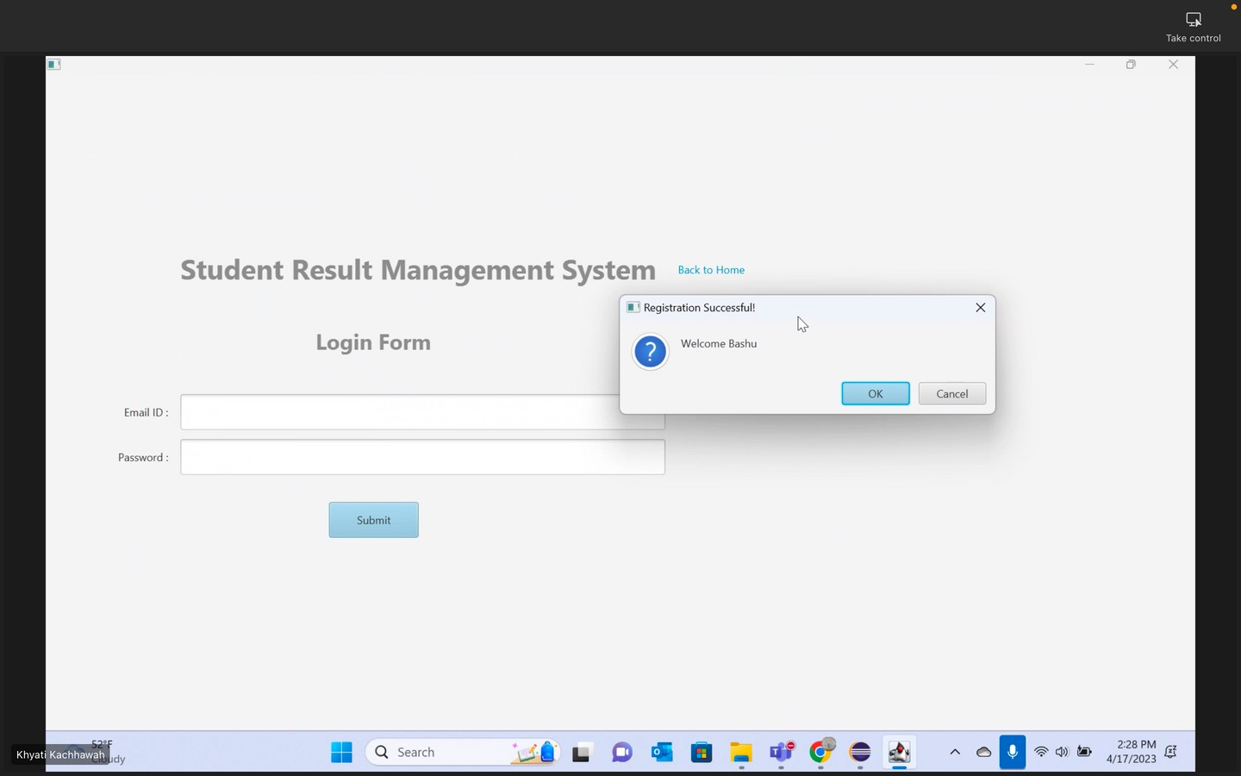
LOGIN PAGE
Primary. fxml -> Login. fxml ( Login page)
Submit button ->
Search Record functions are prompted
Alerts raise on wrong credentials by teacher
On Successful Login -> User Home ( Post Login. fxml)

Slide 11
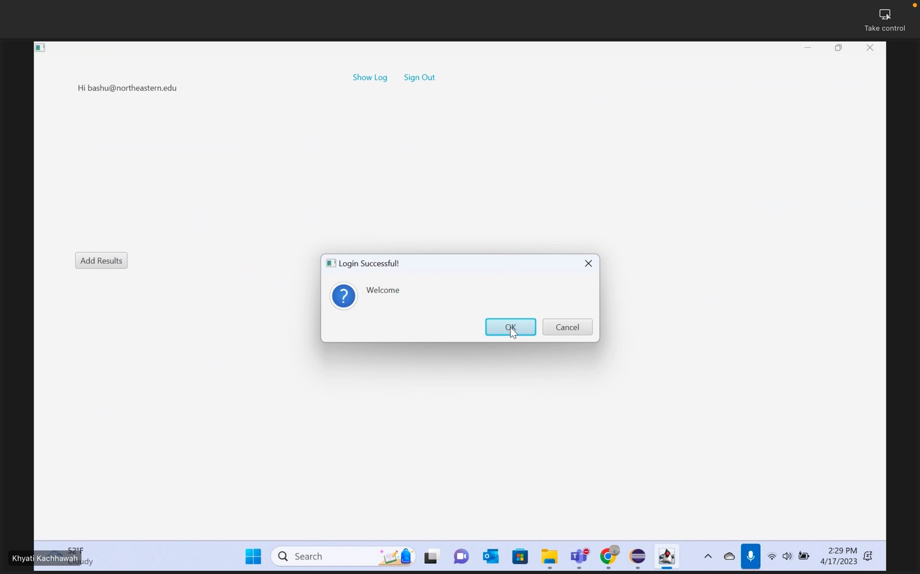
USER HOME
Post Login Controller implements the Initiliazable function
We override initialize function to show labels, text and buttons on page load.
Using List I terator, data is
converted and displayed on Post Login. fxml view page
Read Operation – On page load,
the get Record() function runs and stores data into List<Student>

Slide 12
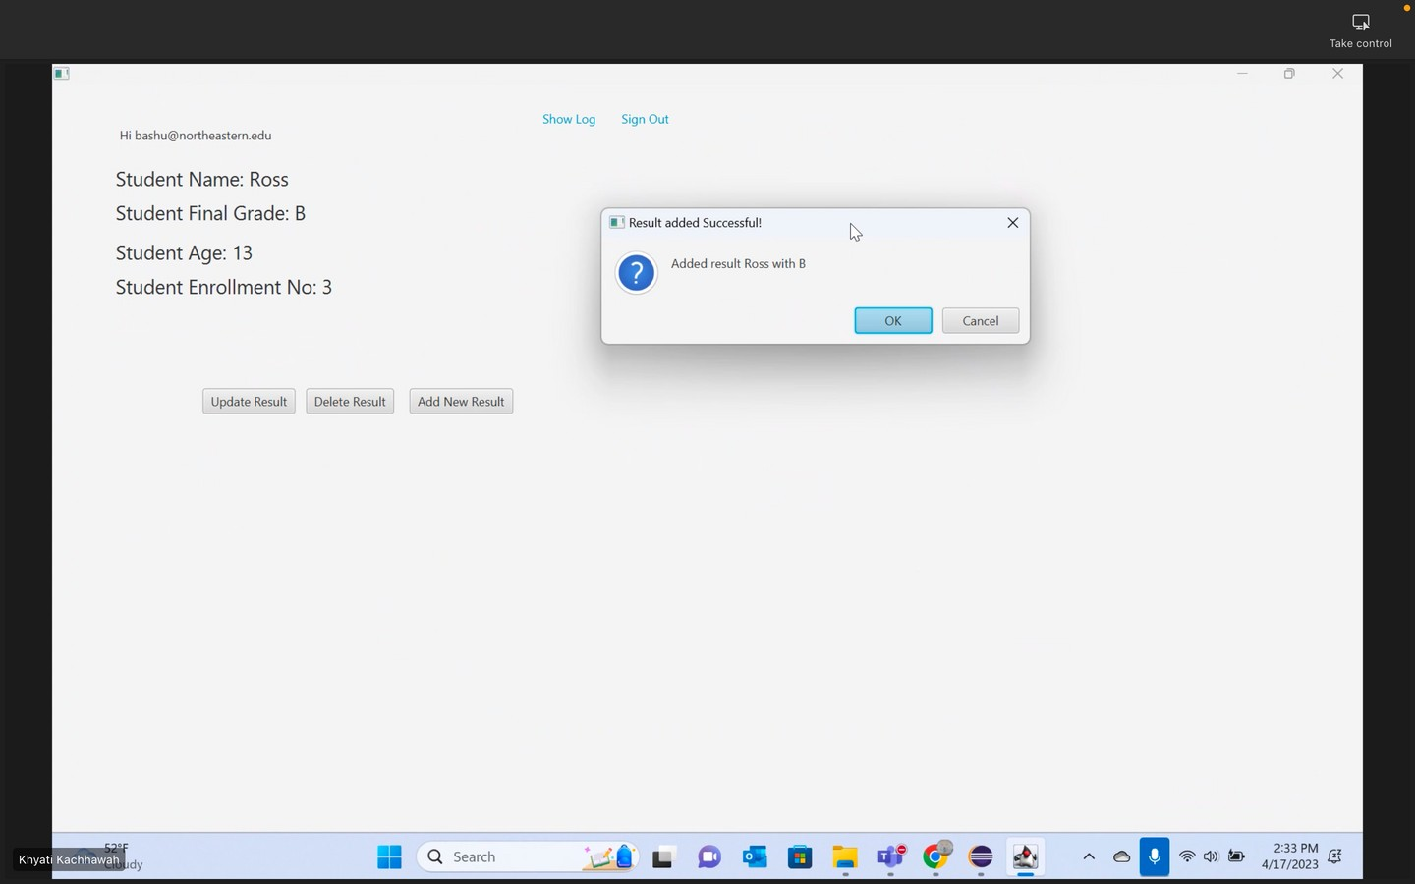
USER HOME
I f the Teacher has no result setup, the ' add result' button is visible
else ' update result' and ' delete result' buttons are shown
Clicking any of these buttons
leads you to add/ update result
page, delete button refreshes the page with your student record
removed from DB.

Slide 13
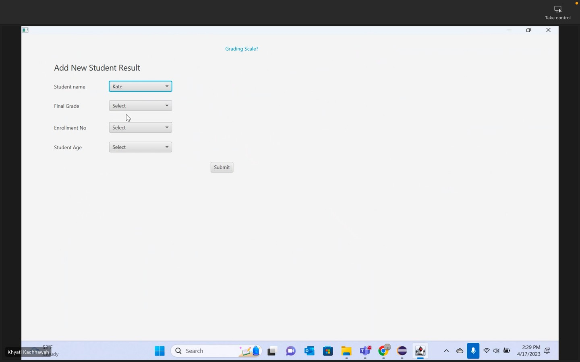
ADD RESULT
Post Login. fxml -> addplan. fxml
Add result button prompts Add new result page for f i rst t ime users to
add a new student result.
Alerts prevent user from submitting the result without selecting all
f ields
Submit button prompts java f i le to add Student information to the
database.
On submitting the result --> Post Login. fxml

Slide 14
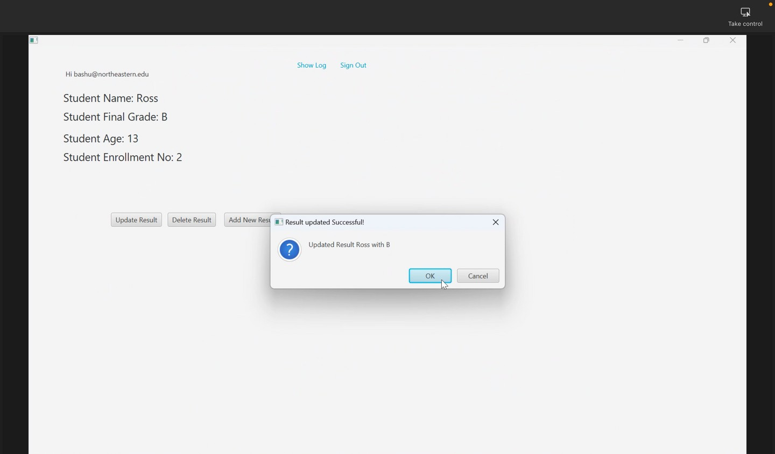
UPDATE RESULT
Update button is visible only i f the teacher has an existing student
result in the database.
Post Login. fxml --> addplan. fxml
Update button retrieves data from Database and shows i t as default in the Combo Box in fxml
Update button prompts java f i le to update current student result
information in the database. On updating the result -->
Post Login. fxml

Slide 15
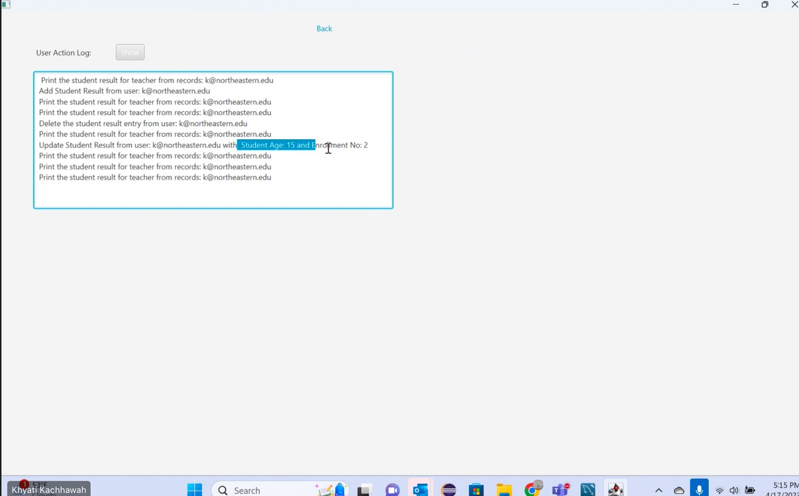
ACTIVITY LOG
For every DB action performed, data is pushed into a stack in the push_log
instance.
Button( show)-> Prints all the actions
performed by teachers after logging in. To print the log, stack is emptied using pop()
To store the order of actions after printing once, we use Deque.
Button ( back) -> Post Login. fxml
When teacher hits on back button, all
data get pushed back to the stack from deque retaining i ts original order.

Slide 16
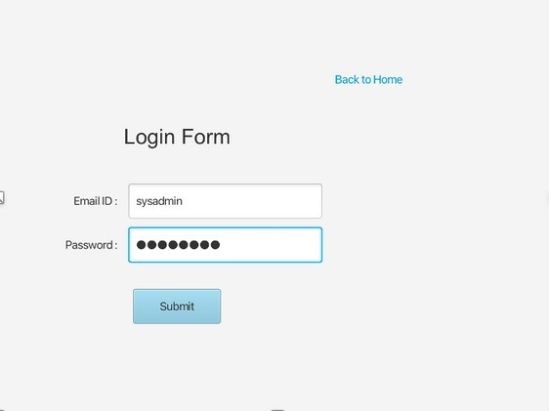
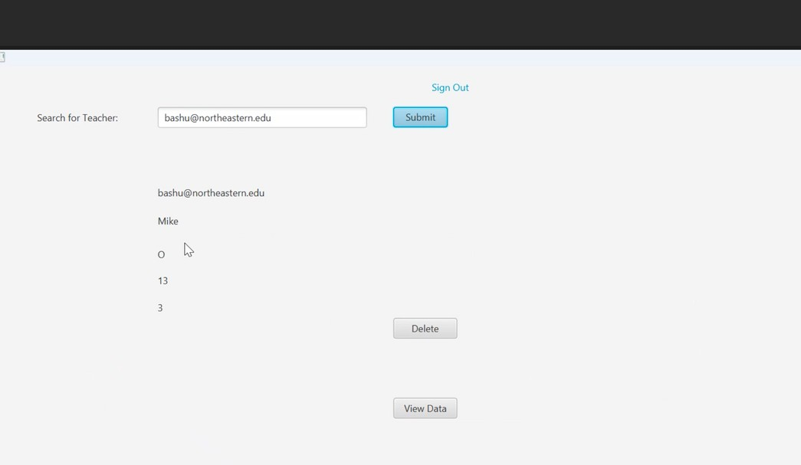
ADMIN- SEARCH AND DELETE
Only Admin has credentials without @ northeastern. edu.
Admin enters string to search
record-> returns student result from database using sql query. Delete-> delete Record instance removes the teacher from
Database.
Signout-> Login. fxml
New admin creation -> Hard coded into JdbcDAO. java / Adding into
database

Slide 17
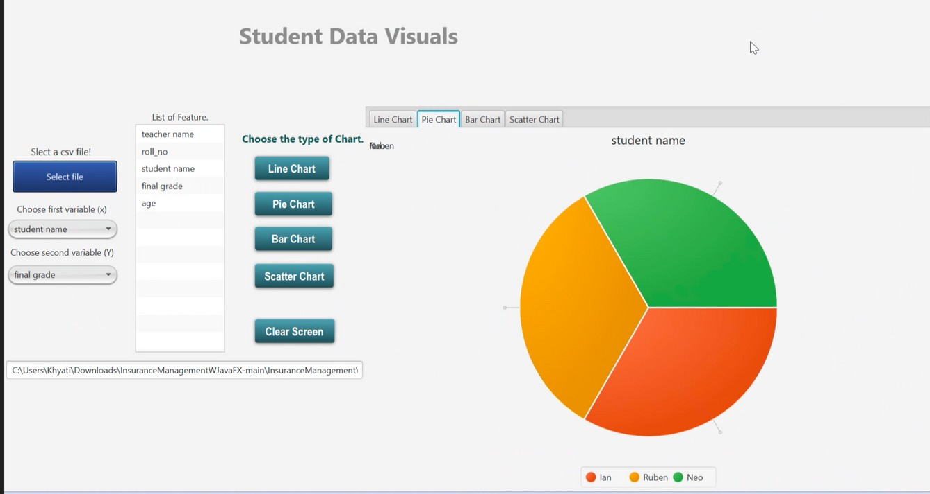
VISUALIZATION
Admin can view student result by
clicking on View Data button which will generate a CSV f i le with the
data fetched from the database. After clicking on View Data, a new window for graph visualization will appear, where admin can select 2 parameters for ' x' and ' y' axis on
which the graphs will give representation of the data selected.
Graphs for visualization contain:
Line chart, Pie chart, Bar graph, and Scatter chart.

Slide 18



FUTURE SCOPE
Improving UI and adding dynamic content on FXML pages
Adding a chat box for teacher to chat about queries and raise questions about guidlines

Slide 19

THANK YOU

